Slide 1

McDonald’s Sales Report
Created by Reina

Slide 2
Table of Contents
Aim
Introduction
Problem statements
Conclusion

Slide 3

Aim To create a report based on the prepared dashboard of McDonald’s sales in the USA

Slide 4

Introduction
The dataset details McDonald’s sales in the South American region for the year 2022.
It highlights various aspects of customer satisfaction and includes key metrics such as the percentage of sales and profit for 2022.

Slide 5
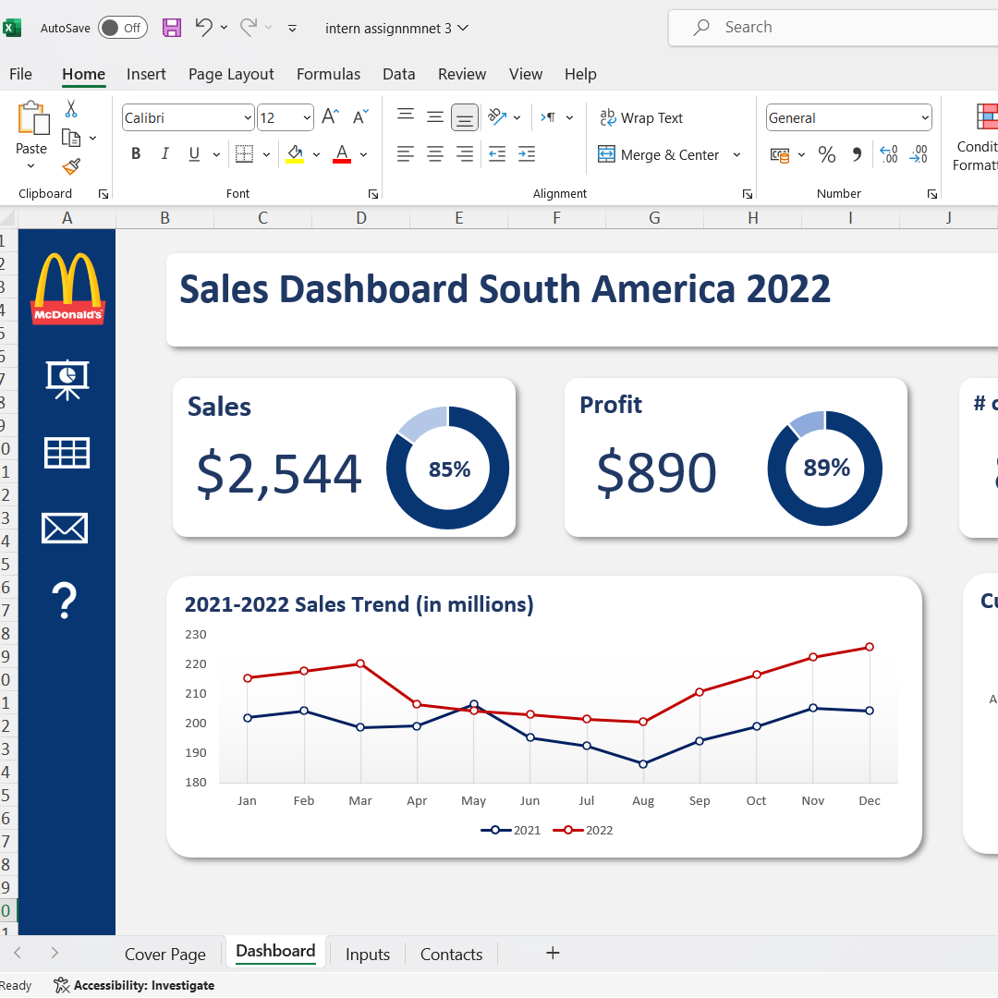
Problem 1 What is the percentage of sales and profit in the year 2022
Sales: 85%
Profit: 89%

Slide 6
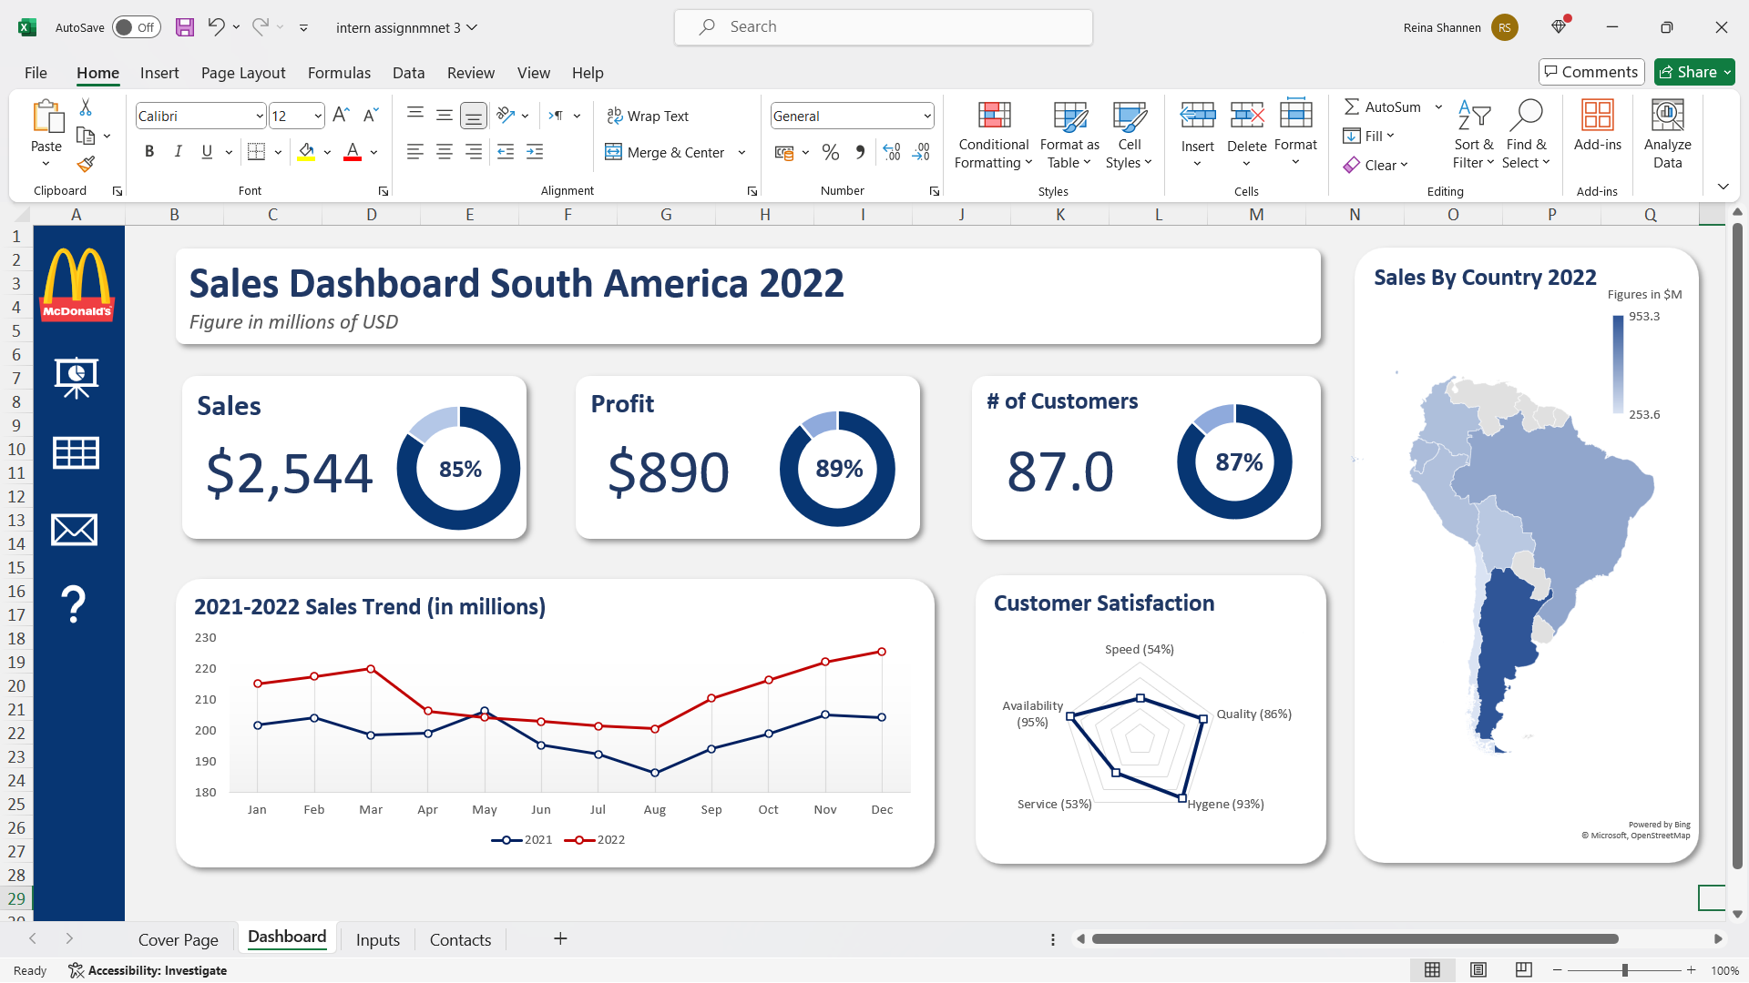
Problem 2 What is the percentage of total customers in the year 2022

Slide 7



Problem 3 How was the sales trend in 2022 compared to that in 2021?
The sales trend for 2021-2022 shows that overall sales in 2022 were higher than in 2021.
There were some fluctuations, particularly in April and May 2022, where sales were lower compared to the same months in 2021.

Slide 8

Conclusion
This dataset shows the overall sales by McDonald’s in the year 2022
It also shows customer satisfaction levels which serves as a key factor to make further improvements in the future
The sales trend of the years 2021 and 2022 are also visualized

